Slide 1
24 Hrs.
Sprint Cadence
Daily Scrum
Product Backlog
Sprint Planning
Sprint Backlog
Sprint Review
Sprint Retrospective
Sprint
Backlog Refinement

Slide 2
Weekly Sprint
Monday
Tues/Wed/Thu
Friday
Refine product backlog first thing Monday morning.
Refine product backlog first thing each morning.
Refine product backlog first thing each morning.
Plan sprint:
Weekly sprint goal
Pull backlog items for the week
Daily scrum
Daily scrum
Daily scrum
Sprint Review
Sprint Retrospective
This takes about the first hour of the day.
This takes about the first 15-30 mins. Of the day
This takes about the first 15-30 mins of the day and the last hour of the day

Slide 3
Retrospective Board
Worked Well
Needs Improvement
Ideas
Actions

Slide 4
Complexity
Simple
Medium
Complex
Personas
Personal account holders
Commercial and Personal Acct Holders
All account holders
Business Rules
Show current statement transactions
User selects statement to see transactions
User enters custom date range
No sorting of transactions
User can sort by date
User can sort by date, amount, type, pending status
No indication of pending transaction
User is shown pending and not with status indicator
User has option to display pending or not
NFR’s
Connection with user must be encrypted
No minimum performance requirements
List must return within 3 second
List must return in less than .5 seconds

Slide 5
Value/Effort Matrix
User can sort by date, amount, type, pending status
All account holders
User is shown pending and not with status indicator
User has option to display pending or not
User can sort by date or amount
Commercial and Personal Acct Holders
Personal account holders
Value
User selects statement to see transactions
User enters custom date range
Show current statement transactions
No sorting of transactions
No indication of pending transaction
Effort

Slide 8
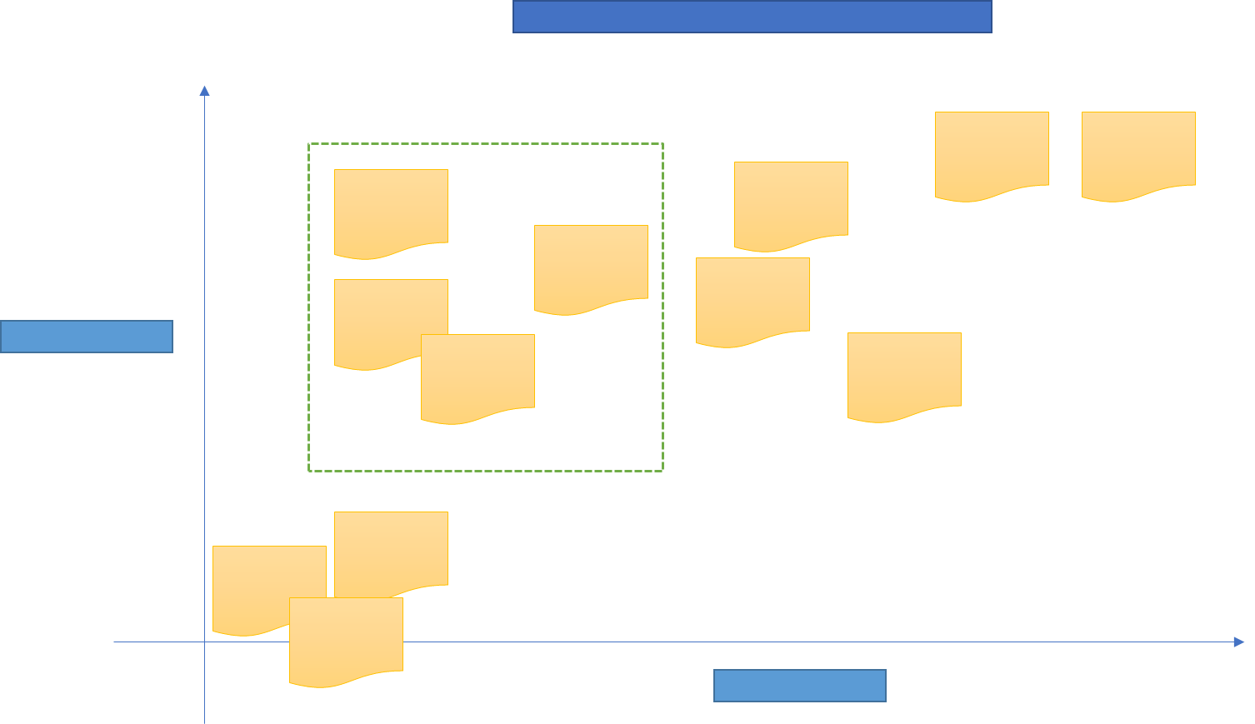

Slide 9


Slide 10
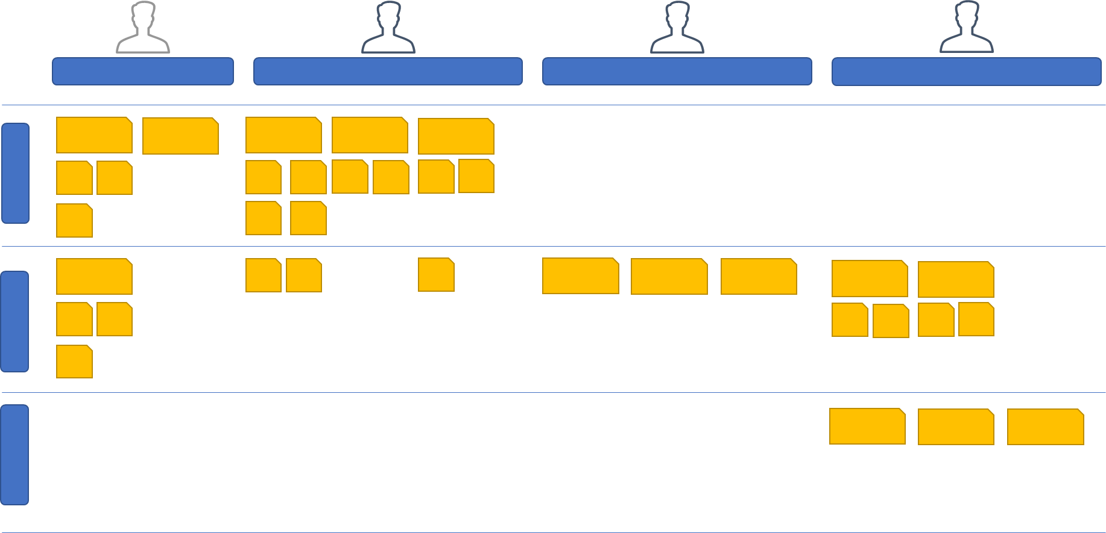

Slide 11
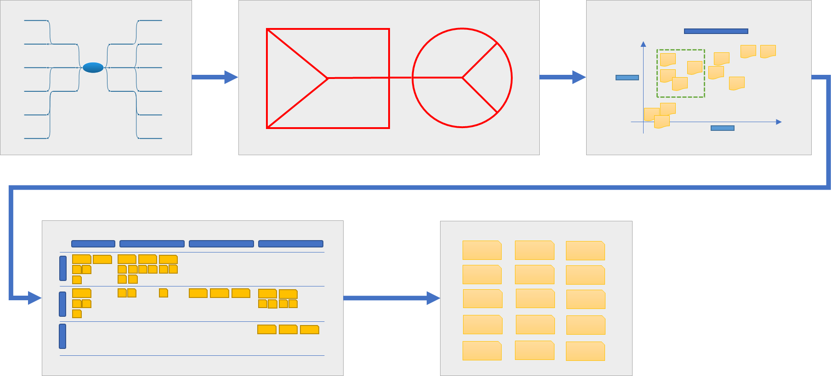

Slide 12
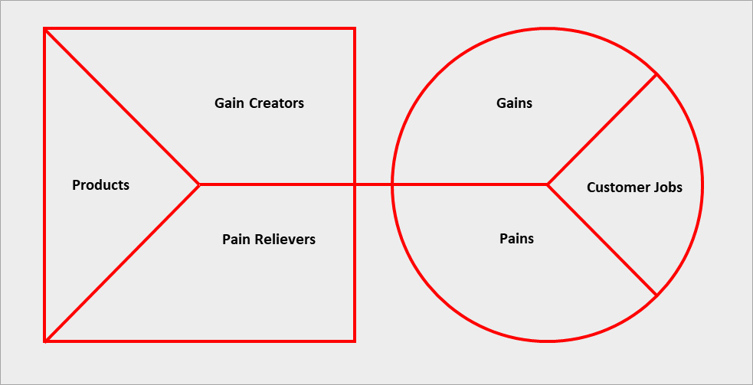
Gain Creators
Gains
Products
Customer Jobs
Pain Relievers
Pains

Slide 13
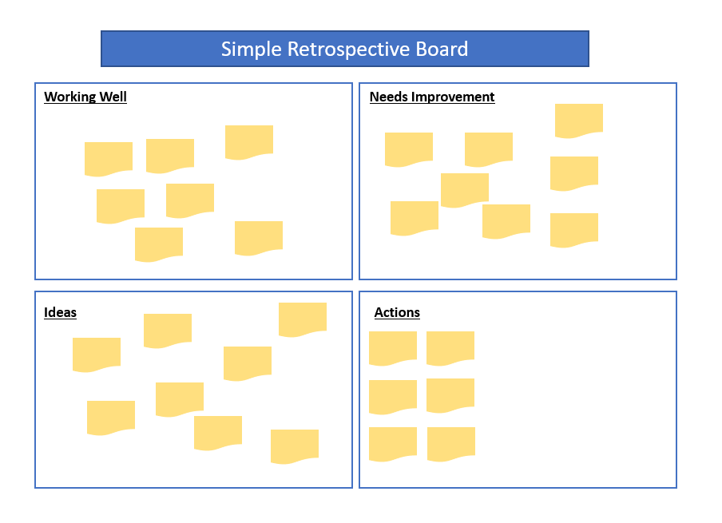
Simple Retrospective Board
Working Well
Needs Improvement
Ideas
Actions

Slide 14
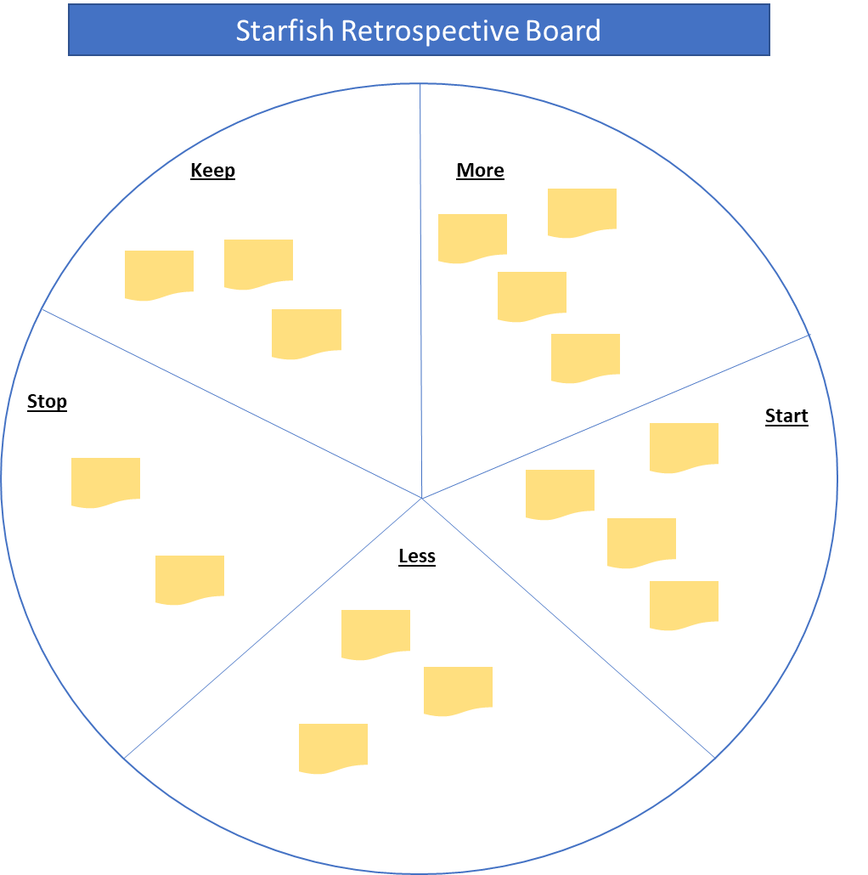
Starfish Retrospective Board
Keep
More
Stop
Start
Less

Slide 15
Relationship Development Plan
Product Alignment
Relationship Goal
Week 1
Week 2
Week 3
Finance transformation
Mature relationship
ERP lead calls to discuss ERP plans
ERP Lead conducts ERP data insights session
ERP lead calls establish monthly meeting
ERP Insights
ERP lead emails Whitepaper on data insights
Shelly, CFO
Cloud transformation
Sustain / Leverage relationship
Customer Success Mgr invites staff to free cloud architecture training
Acct Exec conducts monthly 1:1 meeting
Acct Exec calls to set up cloud envisioning session
Modern workplace
Acct Exec emails research report on Cloud trends
Mary, CIO
Digital Experience Platform
Establish relationship
Acct Exec visits on LI and requests to connect
Acct Exec emails research report on Digital trends
CMO attends webinar
Social listening
Acct Exec email Digital Transformation Whitepaper
Acct Exec invites to webinar about digital exp platform
Acct Exec introduces DXP SME via email
Acct Exec calls and asks for meeting
CMO
Touchpoint Channels
Social
Email
Webinar
Phone Call
Video
Whitepaper
Meeting

Slide 16
Empathize
Define
Ideate
Prototype
Test
Problem Domain
Solution Domain

Slide 17
Empathy Map
Who
What Pains
What does the user say?
What does the user think?
Where
Say
Think
Do
Feel
What Gains
What does the user do?
How does the user feel?
Why

Slide 18
Feedback Capture Matrix
What should be kept?
What should be changed?
Plus
Delta
Idea
Question
What notable ideas were generated?
What questions came up?

Slide 19
2x2 Matrix
Organic
Low Cost
High Cost
Very Processed

Slide 20
Why How Ladder
Because she needs nutrition to live
Because they touch the side of the bowl
She needs nutrition to live
Because it hurts her whiskers when eating
Why does the cat need to eat?
Why do my cat’s whiskers hurt
She eats her food
Why does my cat need her food in the center of the bowl?
They touch the side of the bowl
Give her a bowl that keeps the food in the center of the bowl
My cat needs a bowl that keeps her food in the center

Slide 21
[Persona]
Problem
Situation: Describe the situation that the user is experiencing
Describe the problem and what the user is expecting from the solution
Step 1
Step 2
Step 3
Step 4
Do
Describe what the user does
Think
Describe what the customer is thinking as they do it
Say
Describe what the user says as they do it
Describe how the user feels
Feel

Slide 22
Physical Evidence
Email
Shopping Page
Shopping Cart
Payment Page
Email
Customer Actions
Visit online store
Review sale items
Select item for sale and checkout
Enter payment information and confirm
Confirmation email received
On-stage Actions
Email sales event
Present sales items
Present shopping cart
Present payment screen
Present payment confirmation and send email
Back-stage Actions
CRM generates and send personalized email
Commerce site presents current sale items
Commerce site presents shopping cart
Commerce site checks inventory.
Commerce site checks shipping
Payment processor confirms payment
Confirms payment and send email.
CRM updated.
Support Processes
Customer Analytics
Marketing Plan
Sales Analytics
Inventory management
Picking and shipping process
Payment management process

